Slide 1


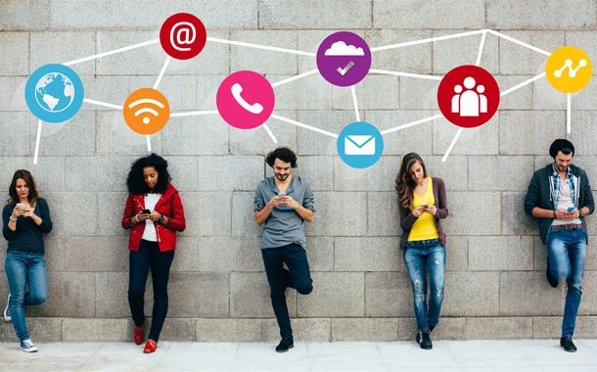
SOCIAL MEDIA & ITS IMPACT on Society

Slide 2
CONTENTS
Overview
Effects Of Social Media On Society
Snapshots From Excel
Visualization In Python
Visualization In Powerbi
Dashboard In Powerbi
Conclusion
References
Video/Audio Clips
Roles In The Project

Slide 3

Overview
Social Media Has Revolutionized The Way We View Ourselves, The Way We See Others And The Way We Interact With The World Around Us.
While Social Media Has Many Positive Implications, Including Promoting Awareness Of Specific Causes, Advertising Businesses And Helping Foster Friendships Between Individuals Who May Have Never Met Without Social Networking, The Over-usage Of Social Media Networks Can Also Lead To Negative Implications.

Slide 4
EFFECTS OF SOCIAL MEDIA ON Society
WHERE DOES HUMANITY MEET TECHNOLOGY?
Personalities and behaviors?
Compassion, empathy, and emotional intelligence? Perceptions of, connection to, and interaction with others?
Addiction In Teens?
Relationships with their families?
Awareness of pitfalls of consumer-based economies? Concepts of and connection to greed?
Engagement in community-based Issues? Politics? Religious
Health & Physical Activity?

Slide 5
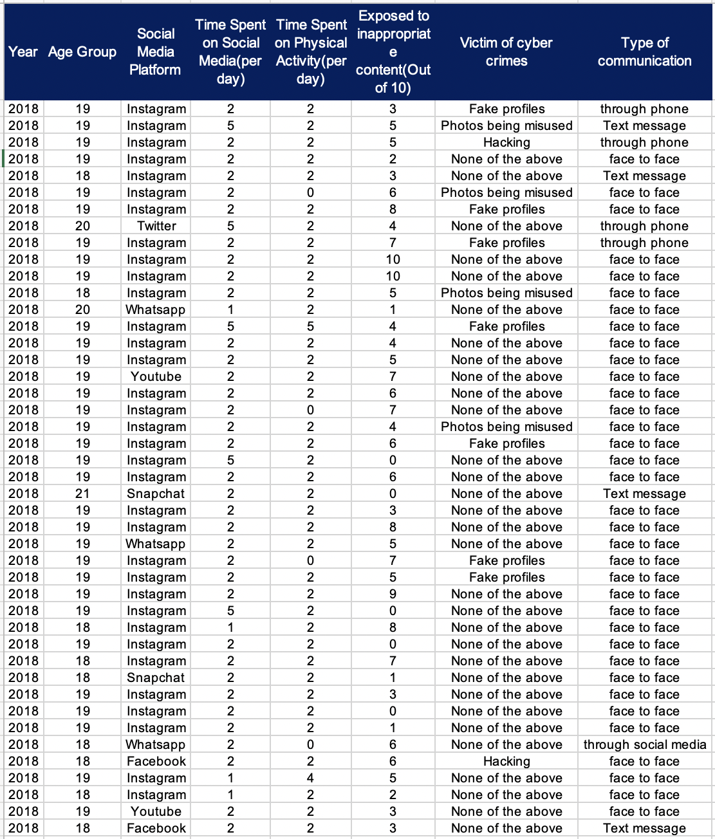
SNAPSHOT FROM EXCEL SHOWING THE DATA

Slide 6
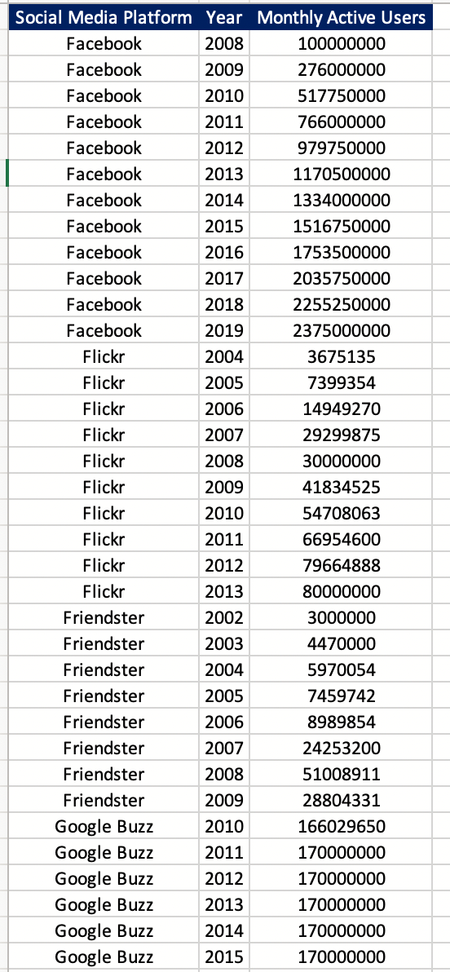
Snapshot From Excel Showcasing Data Of Monthly Active Users On Social Media Platform Every Year

Slide 7
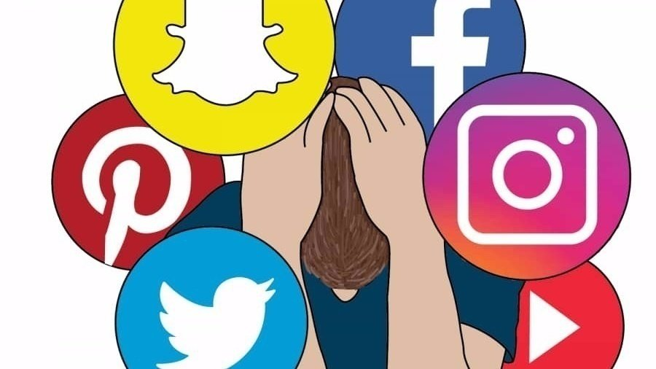
VISUALIZATIONS IN PYTHON

Slide 8
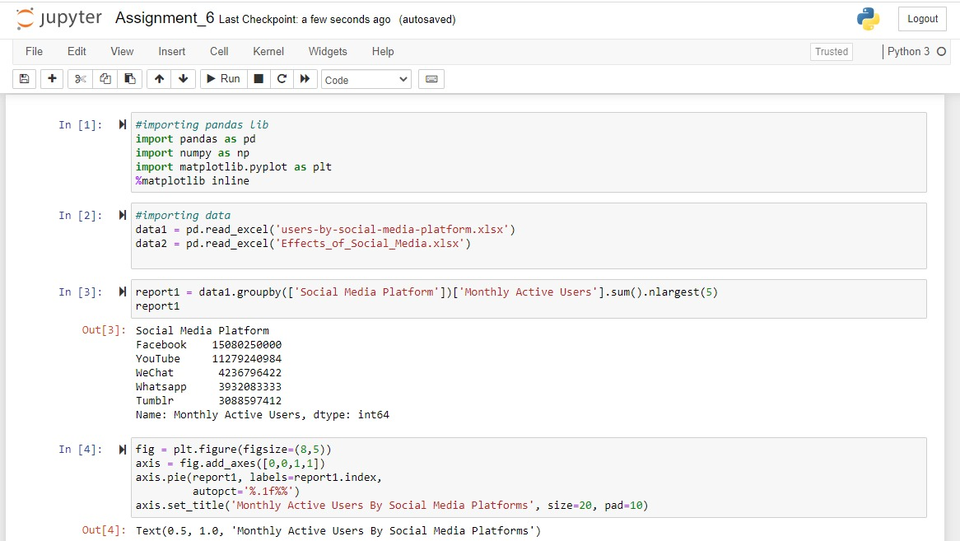
Data manipulation process & coding

Slide 9
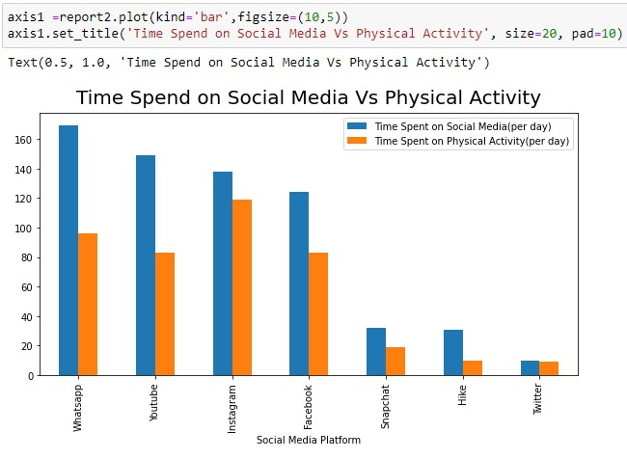
The Bar Plot Represents The Comparison Between The Number Of Users Spend Time On Social Media And Physical Activity According To Different Social Media

Slide 10
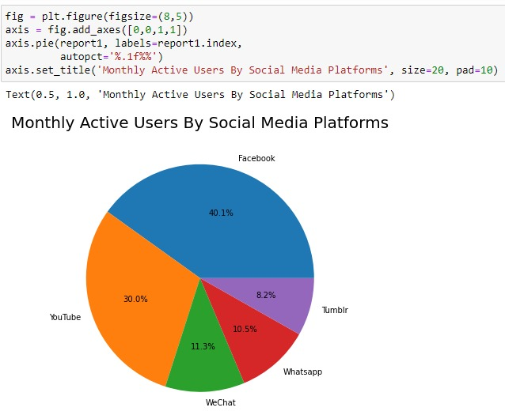
The Pie Chart Is Created To Demonstrate The Monthly Active Uses Of The Top Five Social Media Websites

Slide 11

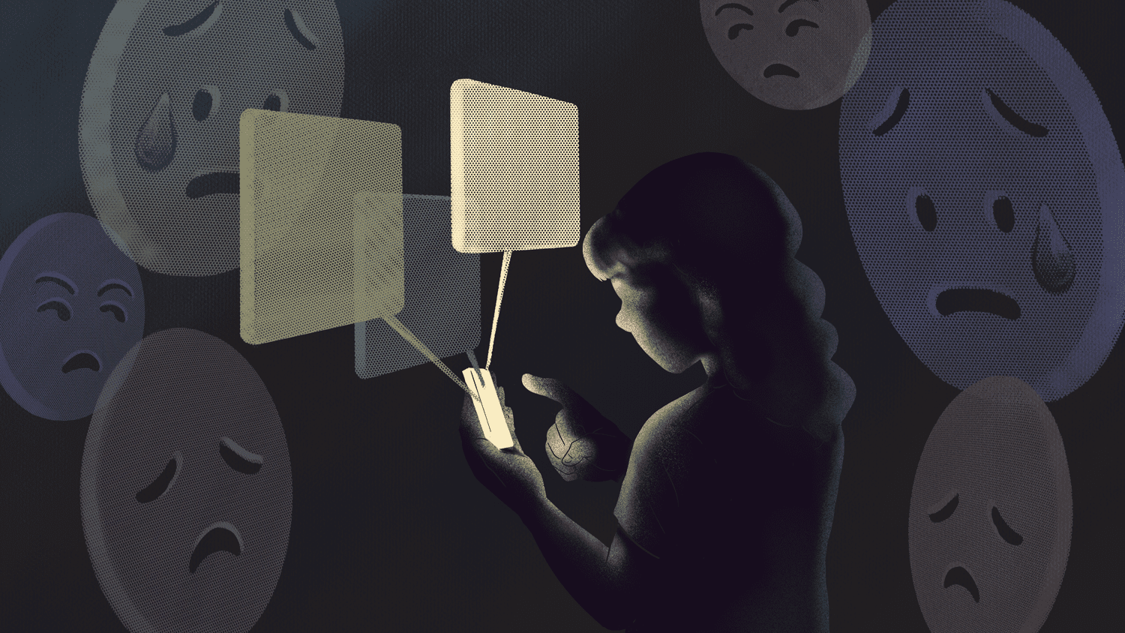
VISUALIZATIONS IN POWER BI

Slide 12
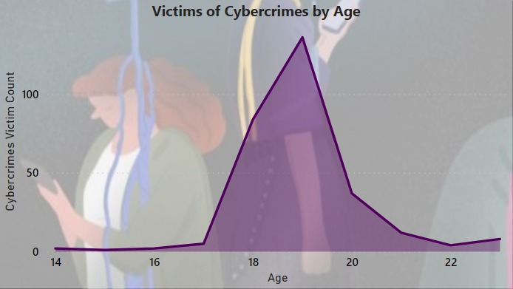
Victims Of Cybercrimes –By Age

Slide 13
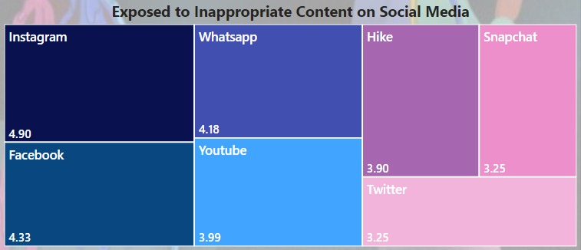
The Tree Map Here Shows The Time People Are Exposed To Inappropriate Contents On Social Media

Slide 14
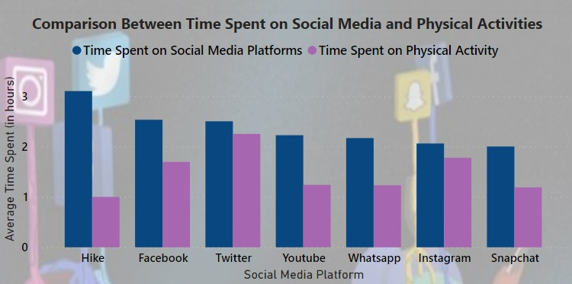
This column chart is used to compare the average time spent (in hours/day)on social media vs the physical activities by the teenagers

Slide 15
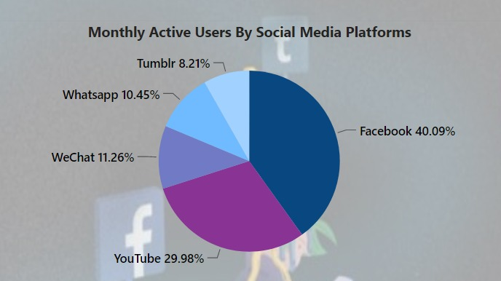
This Pie Chart Is Used To Find The Proportionate Of Monthly Active Users In Social Media Platforms

Slide 16
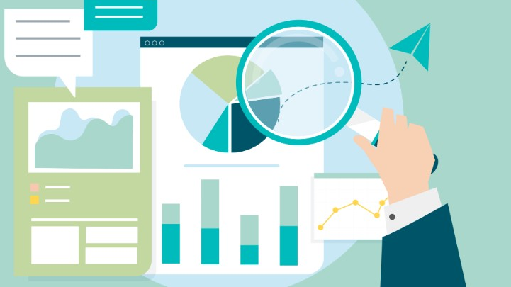

Power Bi DASHBOARD

Slide 17
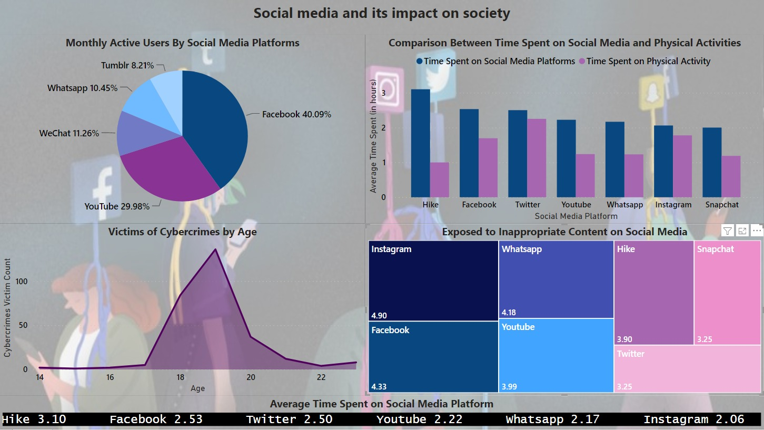

Slide 18
CONCLUSION
It Is Up To Us To Decide How We View Social Media And How We Allow Social Networking To Either Benefit Or Harm Our Lives. It Is Imperative To Remember That The Genuine Human Experience Of Being Able To Communicate In Person, Network In Person And Form Relationships With Others Outweighs Social Media. It Is Also Important To Remember That The Number Of Likes Or Shares You Receive Does Not Define Who You Are Or Your Self-worth.
The More Educated We Become And The Less Time We Spend On Social Media, The More We Realize That There Is A Lot More To Life Than Sitting Behind A Screen All Day Long.

Slide 19

References

